Slide 1

Analyzing of future technological trends by using the latest Stack Overflow Developer Survey dataset
Prepared by:
Fabrice Kouekam Mbouendeu
July12, 2025

Slide 2

Outline
Executive Summary
Introduction
Methodology
Programming Languages Trends
Database Trends
Dashboards
Insights from Dashboard
Findings and Implications
Conclusion

Slide 3
Executive Summary
The Stack Overflow Developer Survey, with responses from over 65,000 developers across 185 countries, offers a compelling snapshot of the current state and future direction of software development. This year's findings underscore a pivotal shift toward AI-driven workflows, evolving developer tools, and the growing importance of developer experience and productivity.
The purpose of our project was finding :
The top 10 programming languages for the current year.
Summarizing the anticipated programming language trends for the next year.
Including findings and implications about the programming language trends
The top 10 databases in use and anticipated future demand.
Including findings and implications about top 10 databases in use and anticipated future demand.

Slide 4
Introduction
The software development landscape is evolving at an unprecedented pace, driven by rapid advancements in artificial intelligence, shifting work models, and the continuous expansion of the global developer community. To better understand these transformations, the Stack Overflow Developer Survey offers critical insights from over 65,000 developers spanning 185 countries. As one of the largest and most trusted annual surveys in the tech industry, it captures key trends in programming languages, tools, workplace dynamics, learning habits, and emerging technologies.
This report aims to synthesize the survey’s findings to provide a clear picture of the current state of software development and where it is headed. From the widespread adoption of AI in developer workflows to the persistent challenges of technical debt and information silos, the data reveals both the opportunities and obstacles facing today’s developers. It also highlights the growing diversity in how developers learn, collaborate, and engage with their work—pointing to the need for adaptable, trust-driven, and productivity-enhancing solutions.
By analyzing the survey results, this report delivers strategic insights for technology leaders, product teams, educators, and developer-focused businesses. It sheds light on where investments should be focused, how tools and platforms must evolve, and what developers truly value as they shape the future of technology.

Slide 5
Methodology
Data source : Stack Overflow Developer Survey dataset from a relational database.
Tasks | Tools
Extract(gathering the data,) Transform(data wrangling , handling duplicates, identifying and addressing missing values) Normalize(normalizing the data) Analyze (Exploratory Data Analysis or EDA, detecting outliers, examine the distribution of responses and identify patterns in developer preferences and technology trends, exploring correlations between various features in the dataset ) | Web-based environment: JupyterNotebook Software: SQL and Python Libraries : Pandas and NumPy Dashboard : IBM Cognos Analytics

Slide 6
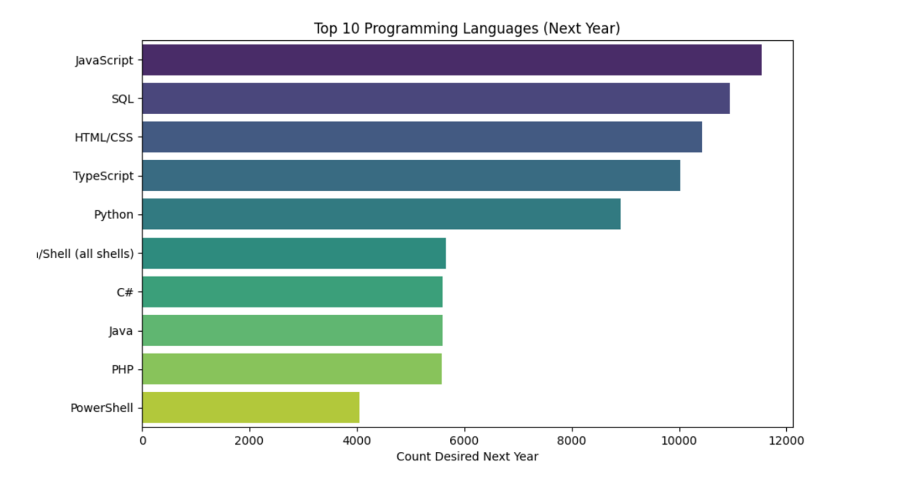
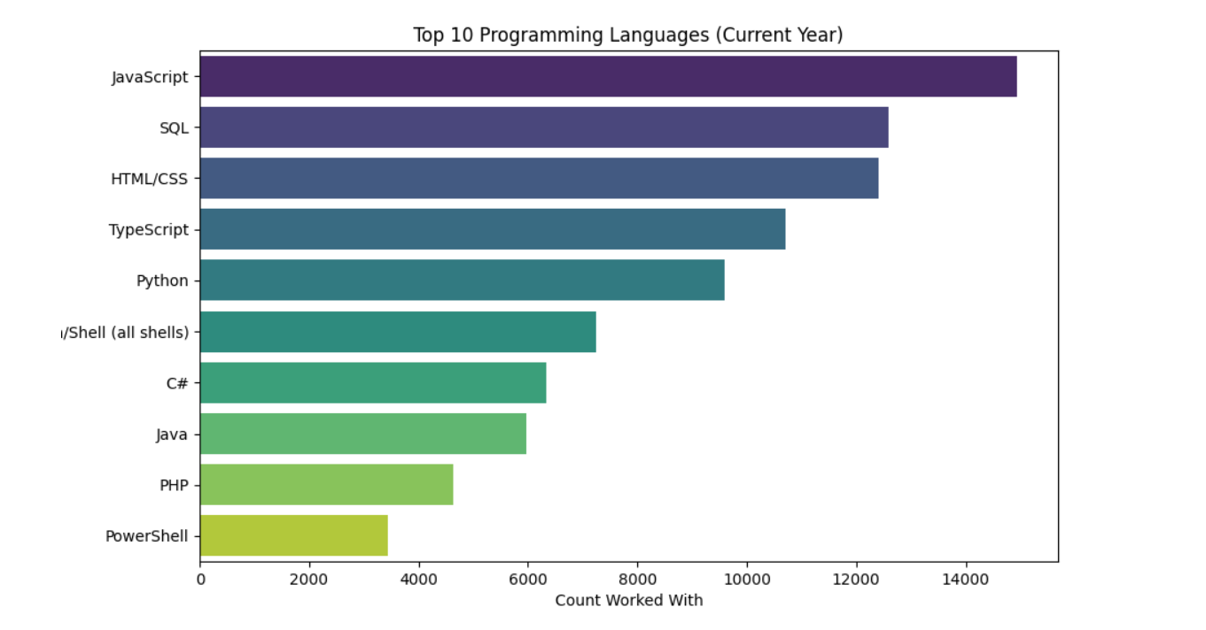
Programming Languages Trends

Slide 7
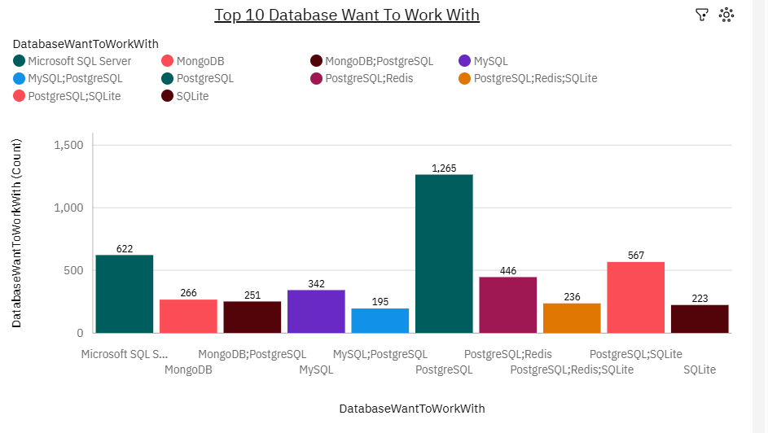
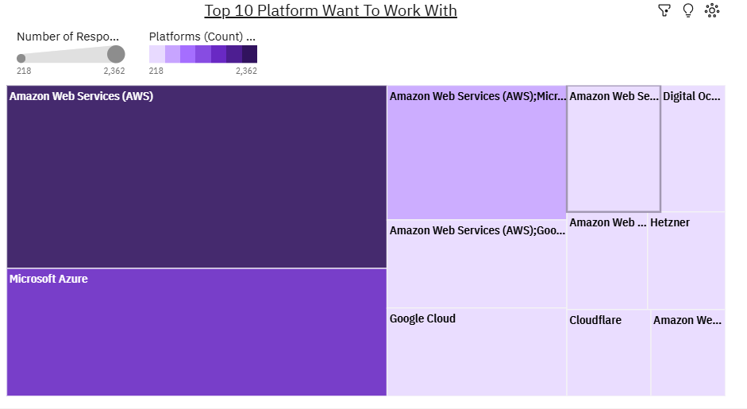

Slide 8
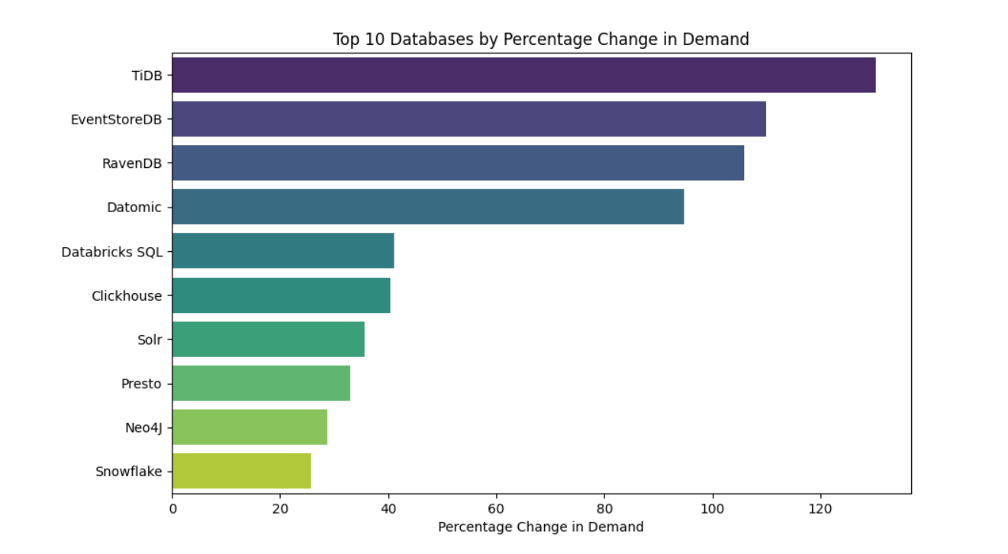
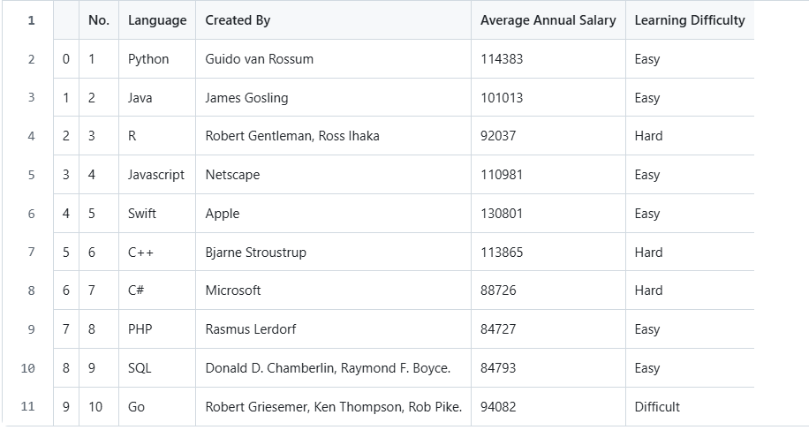
Database Trends

Slide 9
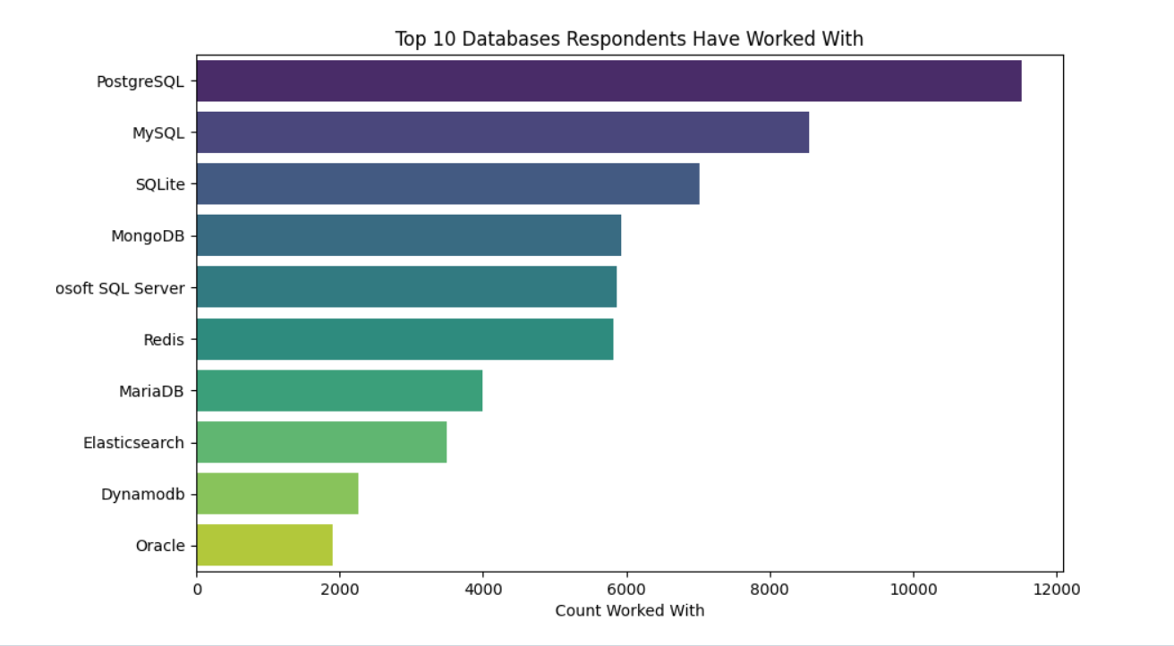
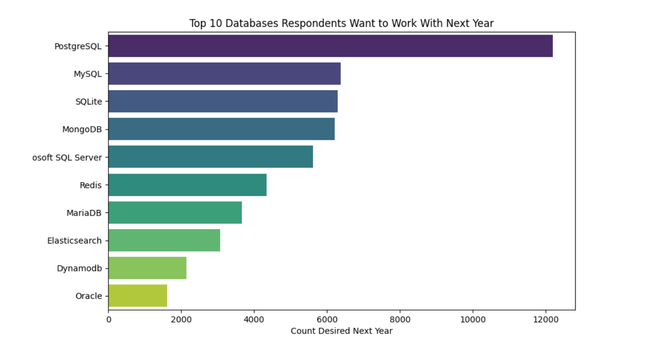

Slide 10
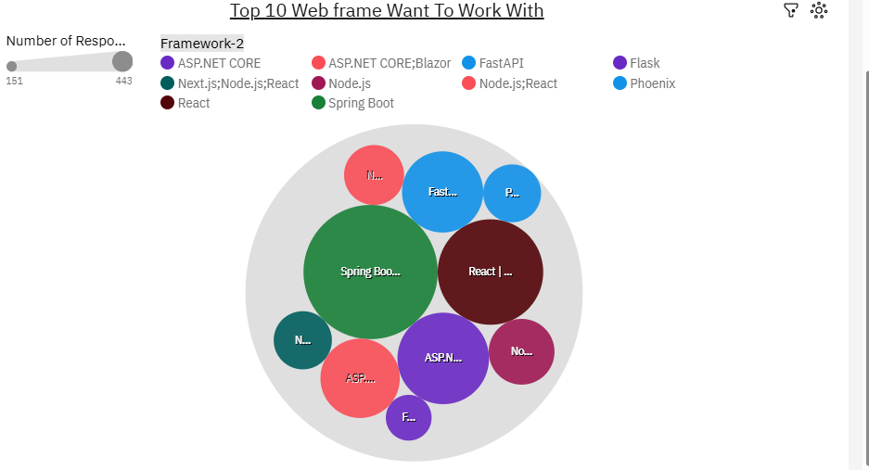
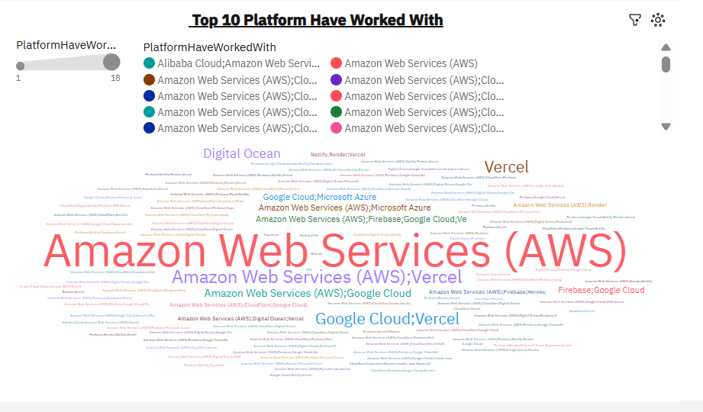

Slide 11
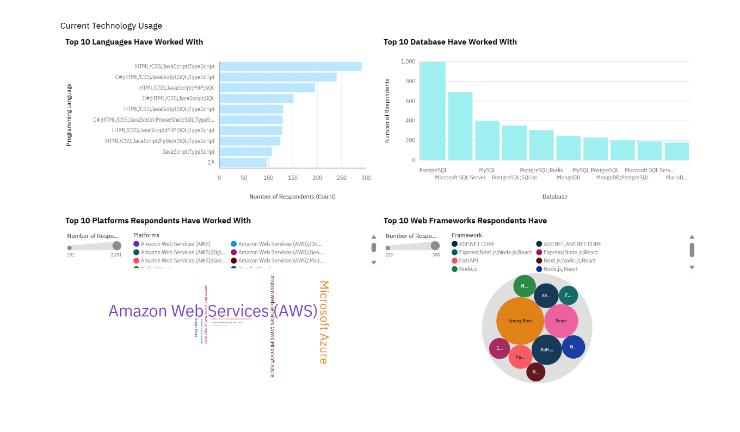
Dashboards

Slide 12
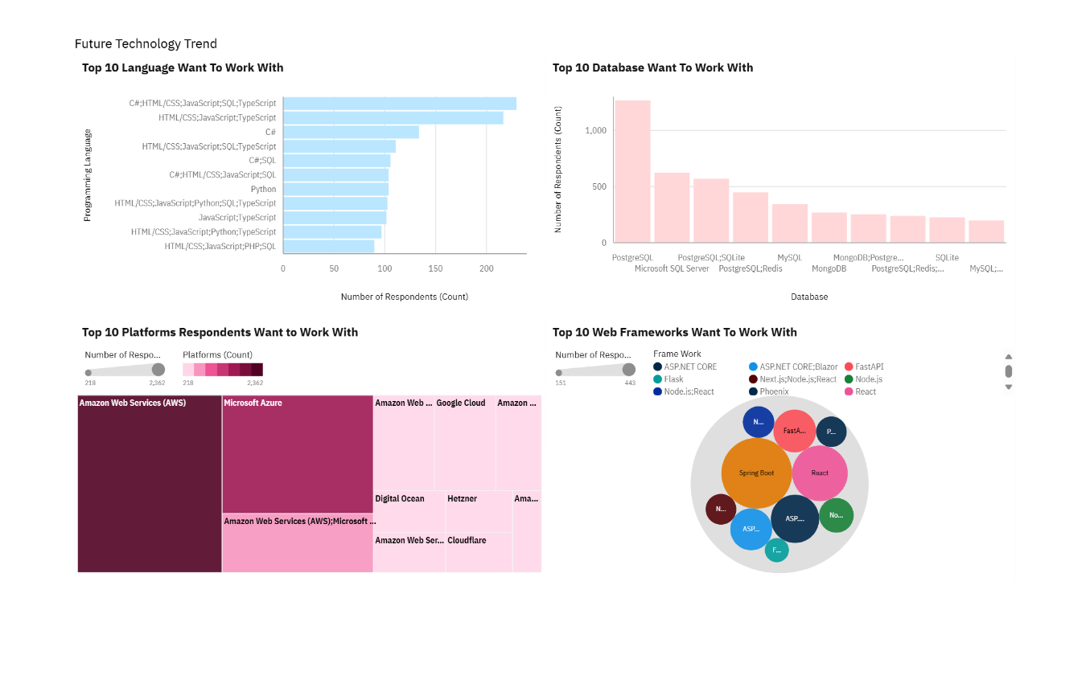

Slide 13
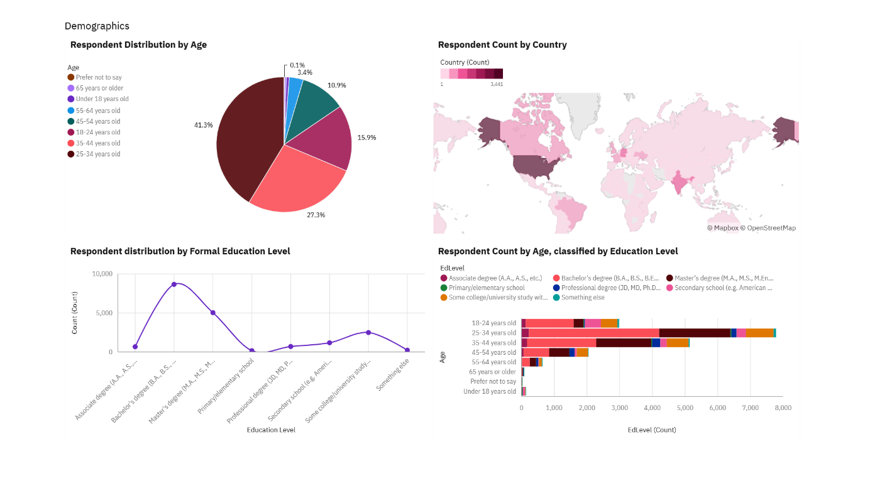

Slide 14
Insights from Dashboard
Developers are embracing AI as a productivity tool but need better trust and integration into existing workflows.
There's a clear shift toward modern, flexible stacks (e.g., Rust, PostgreSQL, cloud-native environments).
Developer experience is critical—tools that reduce friction (technical debt, documentation gaps, tool fragmentation) will thrive.
The industry is becoming more global, diverse, and experience-rich, requiring platforms that cater to a broad range of skill levels and cultural expectations.

Slide 15
Findings and Implications
The Stack Overflow Developer Survey highlights a global developer community that is evolving quickly, embracing AI cautiously, and demanding better tools and support. Organizations that respond by building trustworthy AI solutions, streamlining developer experience, and adapting to remote and hybrid workforces will be best positioned to attract and retain top talent—and to lead the next era of software innovation.

Slide 16
Conclusion
To conclude,
AI tools are widely adopted, but many developers still lack full trust in their accuracy.
Modern technologies like Rust, Go, and PostgreSQL are increasingly preferred for their flexibility and performance.
Developer productivity and automation tools are seen as essential to streamline workflows and reduce technical debt.
Hybrid and remote work models have become the standard in the software industry.
The developer workforce is becoming more experienced, with a growing number of mid- and senior-level professionals.
Most developers prefer self-directed learning through online resources and community platforms.
The global developer community is becoming more diverse, with regional differences in tool preferences and AI adoption.

Slide 17

Thank-you

